Slide 1

Wellcome To Ethical Hacking class 4th Week Day 2nd
Muhammad Bilal

Slide 2
Malware and Backdoors
Definition: Malware is malicious software designed to disrupt, damage, or gain unauthorized access to a computer system. Backdoors are a type of malware that allows attackers to bypass normal authentication methods to gain remote access to a system.
Examples:
1. Trojan Horse: A seemingly legitimate software that, when executed, installs a backdoor allowing the attacker to control the system remotely.
2. Rootkit: A type of malware designed to hide the presence of malicious software by subverting the operating system’s control mechanisms.

Slide 3
Malware and Backdoors
Techniques:
Code Injection:
Injecting malicious code into legitimate software to create backdoors.
Rootkits:
Installing rootkits to hide the presence of backdoors.
Tools/Websites:
Metasploit:
A penetration testing tool that includes modules for backdoor creation.
Cobalt Strike:
A commercial tool used for post-exploitation and backdoor management.

Slide 4
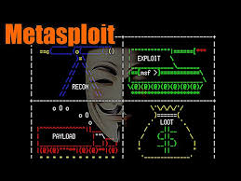


Slide 5
Social Engineering for System Hacking
Definition:
Social engineering involves manipulating people into performing actions or divulging confidential information, often as a precursor to system hacking.
Examples:
1. Pretexting: Creating a fabricated scenario to steal sensitive information from a target.
2. Tailgating: Physically following someone into a restricted area by exploiting their trust.

Slide 6
Social Engineering for System Hacking
Techniques:
Phishing: Sending fraudulent communications that appear to come from a reputable source.
Baiting: Leaving physical media (like a USB stick) that contains malware in a public place.
Tools/Websites:
Social-Engineer Toolkit (SET):
A tool used to simulate social engineering attacks.
PhishTank: A community site where users can verify if an email or website is a phishing attempt.

Slide 7
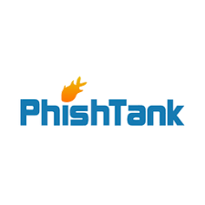


Slide 8
Phishing Attacks
Definition:
Phishing attacks are a type of social engineering where attackers send fraudulent messages designed to trick individuals into revealing sensitive information.
Examples:
1. Credential Harvesting:
A phishing email pretending to be from a bank asks the user to log in via a fake website to steal their credentials.
2. Malware Distribution:
A phishing email contains an attachment that, when opened, installs malware on the victim’s machine.

Slide 9
Phishing Attacks
Techniques:
Email Spoofing:
Forging the sender's address in an email to make it appear legitimate.
Link Manipulation:
Creating a malicious link that looks like a legitimate one but redirects to a fake site.
Tools/Websites:
Gophish: An open-source phishing framework to run phishing campaigns.
PhishMe: A commercial service offering phishing simulation and training.

Slide 10
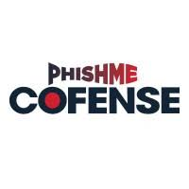


Slide 11
Spear Phishing and Whaling
Definition:
Spear phishing is a targeted form of phishing where attackers personalize their attacks to a specific individual or organization. Whaling is a type of spear phishing aimed at high-profile targets like executives.
Examples:
1. CEO Fraud: A phishing email impersonates a CEO, instructing a subordinate to wire money to a fraudulent account.
2. Personalized Attack: A spear phishing email that uses personal information (like the recipient's name and job title) to make the attack more convincing.

Slide 12
Spear Phishing and Whaling
Techniques:
Reconnaissance: Gathering information about the target to craft a personalized phishing email.
Impersonation: Pretending to be someone the victim trusts, such as a colleague or family member.
Tools/Websites:
Maltego : A tool for gathering information about targets.
King Phisher: A phishing campaign toolkit with support for spear phishing.

Slide 13

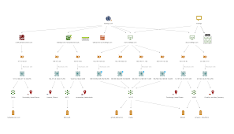

Slide 14
Email Spoofing and Impersonation
Definition:
Email spoofing involves forging email headers so the message appears to come from someone other than the actual sender. Impersonation is pretending to be another person, typically someone in authority or a trusted contact.
Examples:
1. Fake Invoice Email: An attacker spoofs the email address of a vendor to send a fake invoice to a company.
2. Impersonating IT Support: An email that appears to be from the IT department asks employees to reset their passwords through a malicious link.

Slide 15
Email Spoofing and Impersonation
Techniques:
Domain Spoofing: Creating a domain that looks similar to a legitimate one (e.g., using "rnicrosoft.com" instead of "microsoft.com").
Email Header Manipulation: Altering the "From" field in an email header to make it appear as though it came from a trusted source.
Tools/Websites:
SPF/DKIM/DMARC: Email authentication protocols to prevent spoofing.
MXToolbox: A tool to analyze email headers and detect spoofing.

Slide 16



Slide 17
Bypassing Antivirus Software
Definition:
Bypassing antivirus software involves techniques used by attackers to avoid detection by security software.
Examples:
1. Polymorphic Malware: Malware that constantly changes its code to evade signature-based detection by antivirus software.
2. Packing: Compressing or encrypting malware to change its appearance and avoid detection.

Slide 18
Bypassing Antivirus Software
Techniques:
Obfuscation: Hiding the malicious code through encryption or code morphing.
Code Signing: Using legitimate digital certificates to sign malicious code, making it appear trustworthy.
Tools/Websites:
Veil: A tool for generating payloads that bypass antivirus detection.
Shellter: A dynamic shellcode injector capable of evading antivirus software.

Slide 19

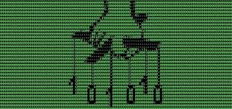

Slide 20
Keyloggers and Spyware
Definition:
Keyloggers are a type of malware that records keystrokes on a victim’s device, while spyware is software designed to gather information about a person or organization without their knowledge.
Examples:
1. Hardware Keylogger : A small device installed between the keyboard and computer to record keystrokes.
2. Adware: Spyware that tracks a user’s browsing habits and displays targeted ads.

Slide 21
Keyloggers and Spyware
Techniques:
Surveillance: Capturing and recording user activity, including keystrokes, screenshots, and browser history.
Data Exfiltration: Sending the captured data back to the attacker.
Tools/Websites:
Keylogger Software: Tools like Spyrix or Elite Keylogger for recording keystrokes.
Spyware Removal Tools: Spybot Search & Destroy and Malwarebytes for detecting and removing spyware.

Slide 22
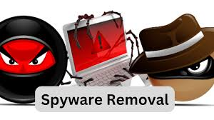
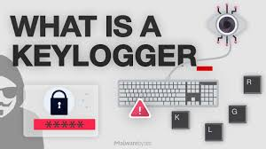

Slide 23
Remote Administration Tools (RATs)
Definition: Remote Administration Tools (RATs) are software that allows a remote user to control a computer as if they were sitting in front of it. They are often used by attackers to gain unauthorized access to a system.
Examples:
1. DarkComet : A widely known RAT used for spying on victims, recording keystrokes, and controlling webcams.
2. njRAT : A RAT that allows attackers to control infected systems remotely, steal data, and deploy additional malware.

Slide 24
Remote Administration Tools (RATs)
Techniques:
Remote Control: Controlling the victim’s computer remotely, including file access, keystroke logging, and webcam surveillance.
Persistence: Ensuring the RAT remains on the system even after a reboot or security updates.
Tools/Websites:
DarkComet RAT: A commonly used remote administration tool.
Metasploit: A penetration testing framework that includes RAT functionalities.

Slide 25
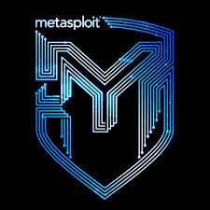
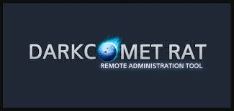

Slide 26
Advanced Persistent Threats (APTs)
Definition:
APTs are prolonged and targeted cyberattacks where an intruder gains access to a network and remains undetected for an extended period, usually to steal sensitive data.
Examples:
1.Operation Aurora: A series of cyberattacks conducted by China-based hackers targeting U.S. companies, including Google.
2.Stuxnet: A highly sophisticated APT designed to sabotage Iran’s nuclear program by targeting its industrial control systems.

Slide 27
Advanced Persistent Threats (APTs)
Techniques:
Zero-Day Exploits:
Exploiting unknown vulnerabilities in software to gain unauthorized access.
Lateral Movement: Moving within a network to access different systems and extract valuable data.
Tools/Websites:
APT Groups Tracking: Websites like MITRE ATT&CK provide detailed profiles of known APT groups.
Cobalt Strike: A tool used by attackers to simulate APTs and conduct post-exploitation activities.

Slide 28
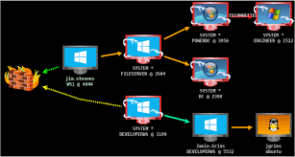


Slide 29
Fileless Malware
Definition:
Fileless malware is a type of malicious software that operates in memory and does not write any files to the disk, making it difficult to detect with traditional antivirus solutions.
Examples:
1. PowerShell-Based Attacks: Attackers use PowerShell scripts that execute in memory, bypassing traditional security mechanisms.
2. Living-off-the-L and Attacks: Leveraging legitimate tools and processes already present on the system (e.g., PowerShell or Windows Management Instrumentation).

Slide 30
Fileless Malware
Techniques:
Memory-Only Malware: Storing and executing the malicious payload entirely in memory.
Leveraging Legitimate Tools: Using tools like PowerShell or WMI to carry out attacks without leaving a footprint.
Tools/Websites:
Cylance: An AI-based security solution that detects fileless malware.
PowerShell Empire: A post-exploitation tool used to deploy fileless attacks.

Slide 31



Slide 32
Post-Exploitation Techniques
Techniques:
Credential Dumping: Extracting password hashes and other credentials from the system.
Lateral Movement: Moving from one compromised system to another within a network.
Tools/Websites:
Mimikatz: A tool used for extracting plaintext passwords, hash dumps, and other credential-related information.
BloodHound: A tool for analyzing Active Directory environments and identifying potential attack paths.

Slide 33
Post-Exploitation Techniques
Definition:
Post-exploitation refers to the actions taken by an attacker after gaining access to a system to maintain control, gather more data, or prepare for further attacks.
Examples:
1. Privilege Escalation: Gaining higher privileges on a compromised system to access more sensitive information or critical system resources.
2. Persistence Mechanisms: Installing backdoors or modifying system settings to ensure continued access after the initial compromise.

Slide 34

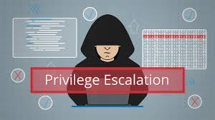

Slide 35
Exploitation Frameworks
Definition:
Exploitation frameworks are tools that provide a structured environment for developing, testing, and deploying exploits against vulnerable systems.
Examples:
1. Metasploit Framework: A widely used penetration testing framework that allows users to find, exploit, and validate vulnerabilities.
2. Core Impact: A commercial exploitation framework designed for penetration testers and security professionals.

Slide 36
Exploitation Frameworks
Techniques:
Automated Exploitation: Using pre-built modules to exploit known vulnerabilities with minimal manual intervention.
Custom Exploit Development: Writing and testing custom exploits using the framework’s tools.
Tools/Websites:
Metasploit: The most popular exploitation framework.
Immunity Canvas: A commercial penetration testing tool similar to Metasploit.

Slide 37

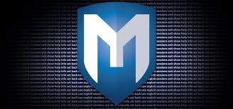

Slide 38
Legal and Ethical Aspects of System Hacking
Definition:
The legal and ethical aspects of system hacking involve understanding the laws, regulations, and ethical guidelines that govern hacking activities, particularly in penetration testing and cybersecurity research.
Examples:
1. Unauthorized Access: Accessing a system without permission is illegal and considered unethical, even if no harm is done.
2. Penetration Testing: Performing security assessments on a system with explicit permission from the owner is legal and ethical.

Slide 39
Legal and Ethical Aspects of System Hacking
Techniques:
Obtaining Written Consent: Always secure written consent before performing any hacking or penetration testing activities.
Following Ethical Guidelines: Adhere to industry standards like the **EC-Council Code of Ethics.
Tools/Websites:
OWASP: Provides guidelines and best practices for ethical hacking and secure coding.
ISACA: Offers certifications like CISM and CRISC that emphasize ethical practices in cybersecurity.

Slide 40

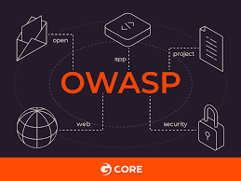

Slide 41
Happy Hacking

